Slide 1
Module 5 – Probability and Counting

Slide 2
Terminologies
Probability: A number between 0 and 1 (inclusive) to indicate how likely an event will occur.
Experiment: A process that leads to the occurrence of one and only one of several possible results.
Outcome: A particular result of an experiment.
Event: A collection of one or more outcomes of an experiment.
Sample space: The collection of all possible outcomes. Suppose a coin is flipped, the sample space is S = {T, H}.
Suppose 2 coins are flipped, there are 4 possible outcomes, so the sample space is S = {TT, TH, HT, HH }.

Slide 3
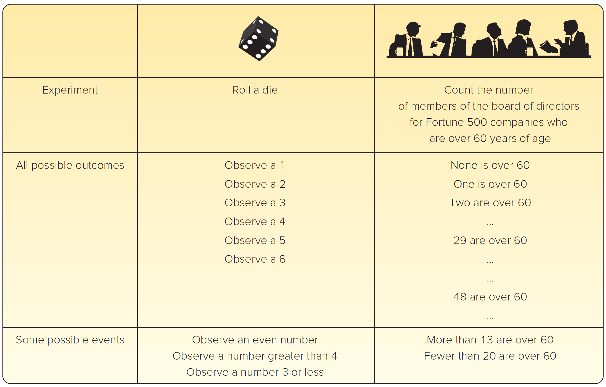
Example

Slide 4
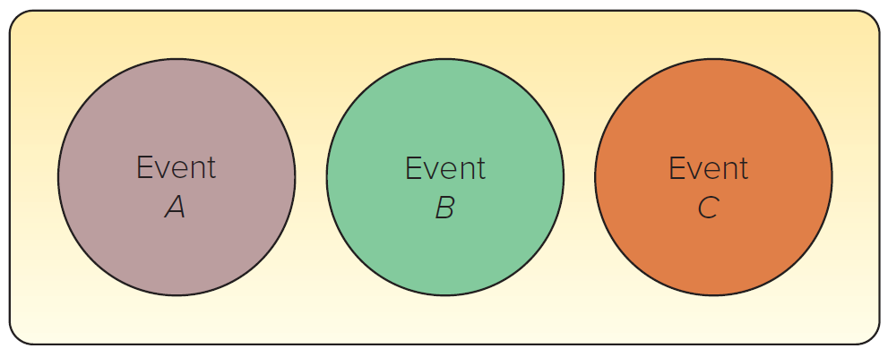
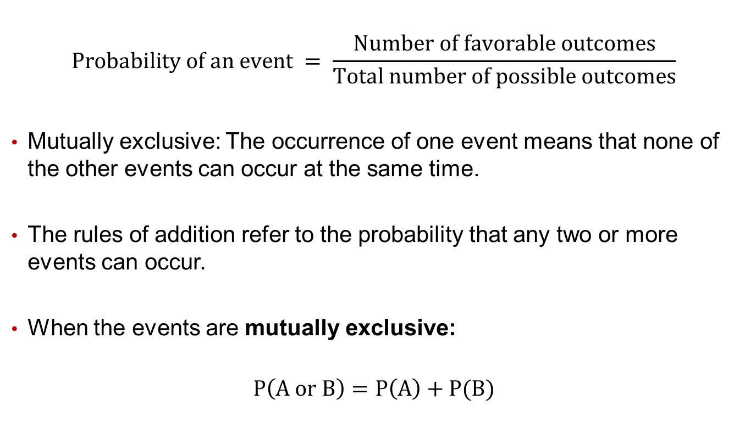
Classical Probability
$$Probability of an event = \frac{Number of favorable outcomes}{Total number of possible outcomes}$$
Mutually exclusive: The occurrence of one event means that none of the other events can occur at the same time.
The rules of addition refer to the probability that any two or more events can occur.
When the events are mutually exclusive:
$$P\left(A or B\right)=P\left(A\right)+P(B)$$

Slide 5
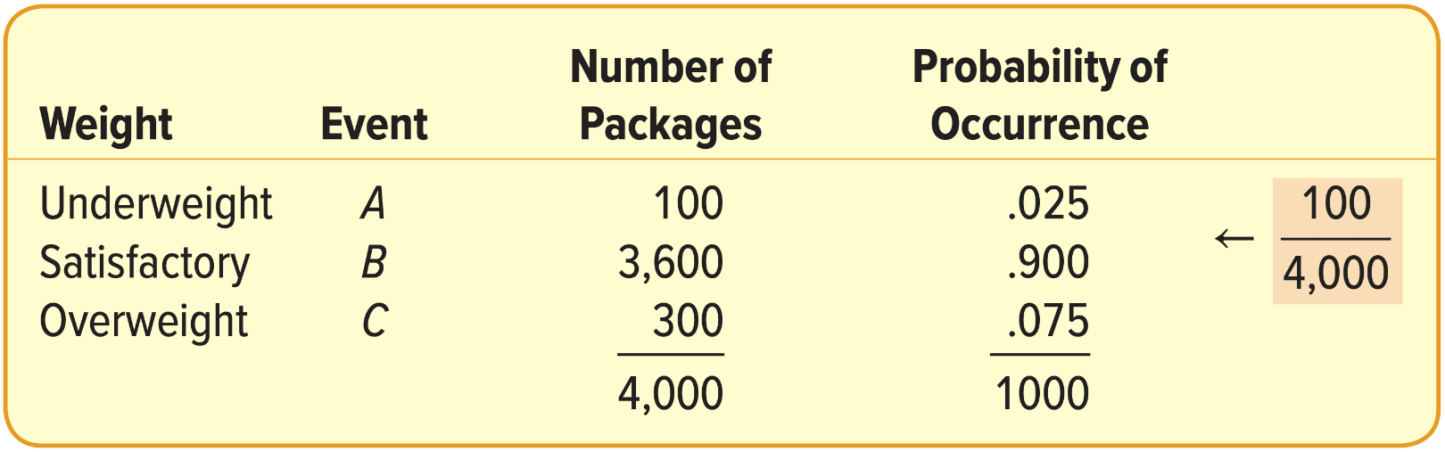
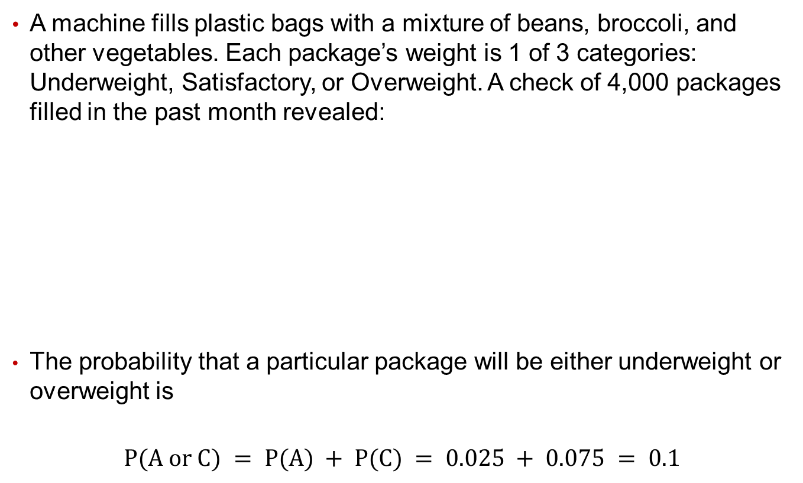
Rules of Addition Example
A machine fills plastic bags with a mixture of beans, broccoli, and other vegetables. Each package’s weight is 1 of 3 categories: Underweight, Satisfactory, or Overweight. A check of 4,000 packages filled in the past month revealed:
The probability that a particular package will be either underweight or overweight is
$$P(A or C) = P(A) + P(C) = 0.025 + 0.075 = 0.1$$

Slide 6
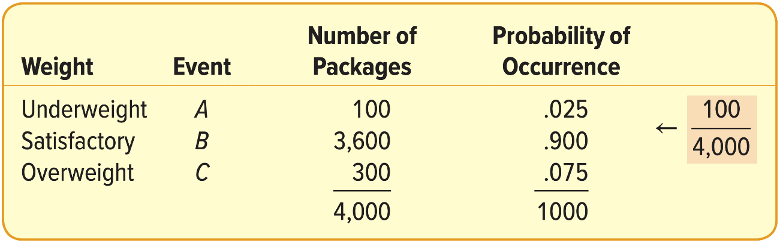
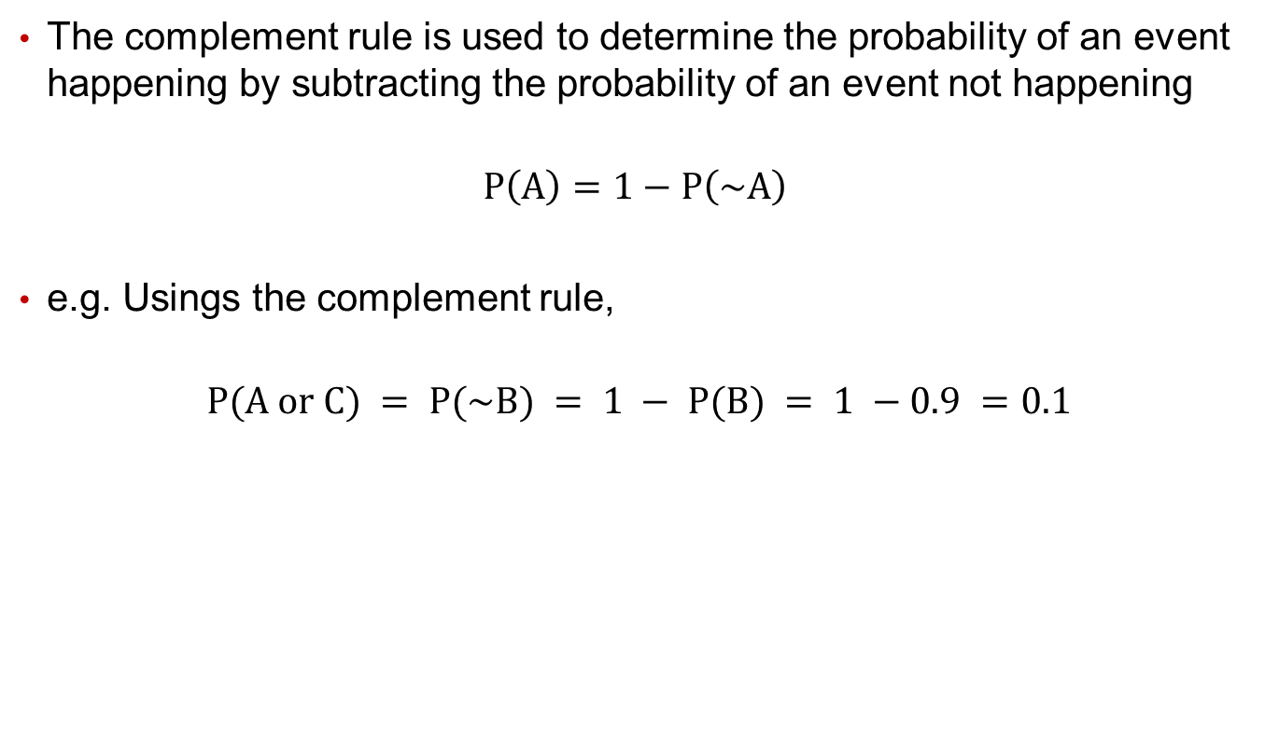
Complement Rule
The complement rule is used to determine the probability of an event happening by subtracting the probability of an event not happening
$$P\left(A\right)=1−P\left(\sim A\right)$$
e.g. Usings the complement rule,
$$P(A or C) = P(\sim B) = 1 − P(B) = 1 −0.9 =0.1$$

Slide 7
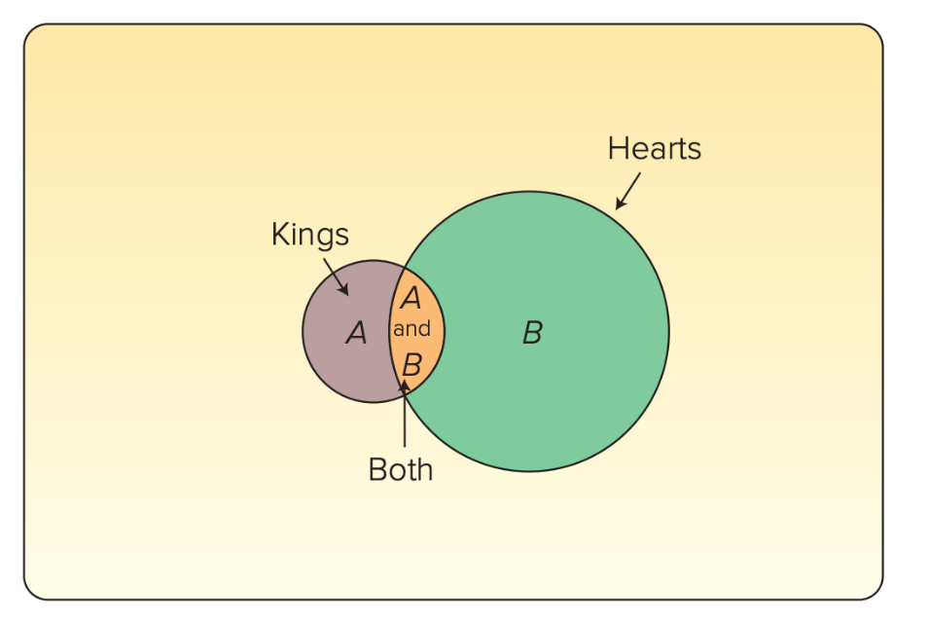

General Rule of Addition
The general rule of addition is used when the events are not mutually exclusive
$$P\left(A or B\right)=P\left(A\right)+P\left(B\right)−P\left(A and B\right)$$
Joint probability: A probability that measures the likelihood two or more events will happen concurrently.

Slide 8
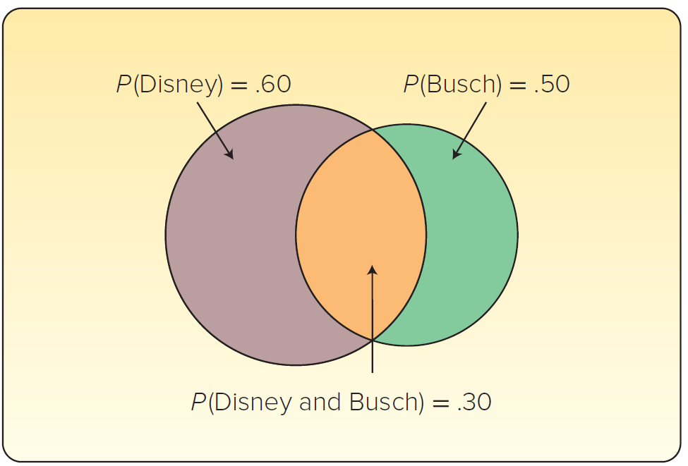
General Rule of Addition Example
A sample of 200 tourists in Florida shows 120 went to Disney, 100 went to Busch Gardens, and 60 visited both.
P(Disney) = 120/200 = 0.6
P(Busch) = 100/200 = 0.5
P(Disney and Busch) = 60/200 = 0.3
P(Disney or Busch) = P(Disney) + P(Busch) − P (Disney and Busch)
= 0.60 + 0.50 − 0.30 = 0.80

Slide 9
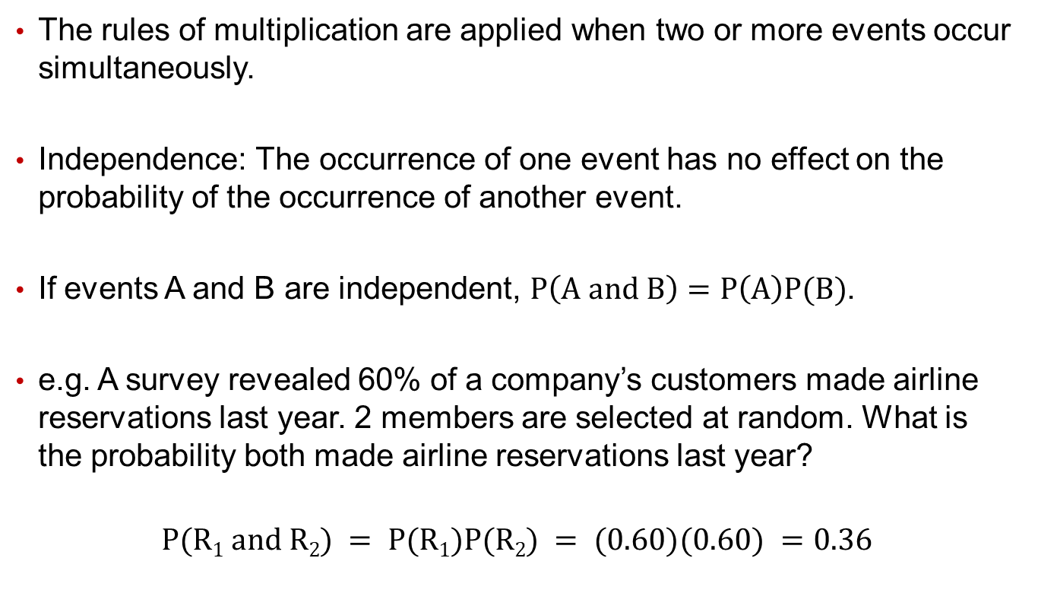
Independent Events
The rules of multiplication are applied when two or more events occur simultaneously.
Independence: The occurrence of one event has no effect on the probability of the occurrence of another event.
If events A and B are independent, $P\left(A and B\right)=P\left(A\right)P(B)$.
e.g. A survey revealed 60% of a company’s customers made airline reservations last year. 2 members are selected at random. What is the probability both made airline reservations last year?
$$P(R1 and R2) = P(R1)P(R2) = (0.60)(0.60) =0.36$$

Slide 10
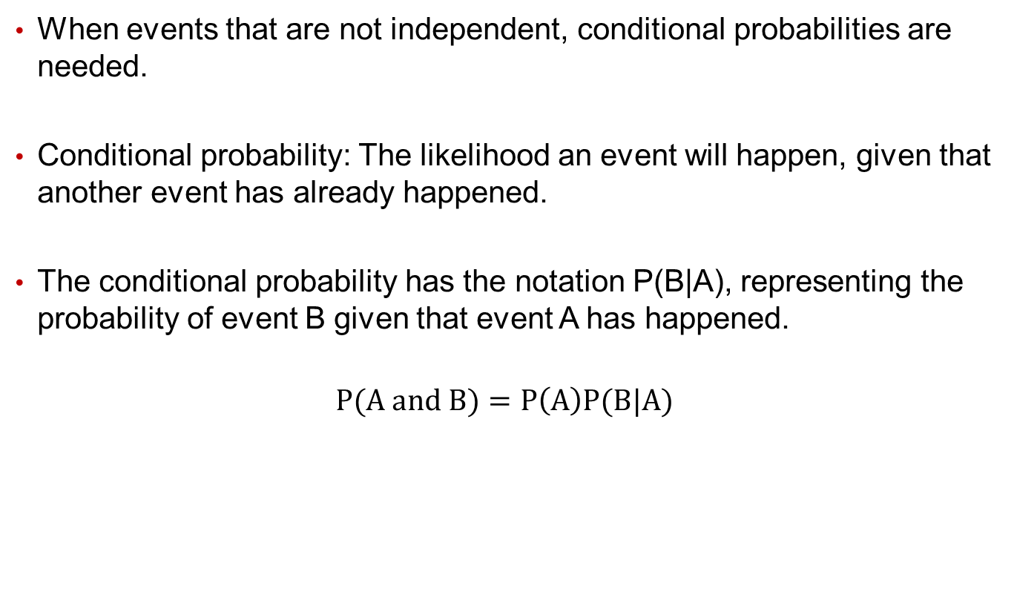
Conditional Probability
When events that are not independent, conditional probabilities are needed.
Conditional probability: The likelihood an event will happen, given that another event has already happened.
The conditional probability has the notation P(B|A), representing the probability of event B given that event A has happened.
$$P(A and B)=P\left(A\right)P(B|A)$$

Slide 11
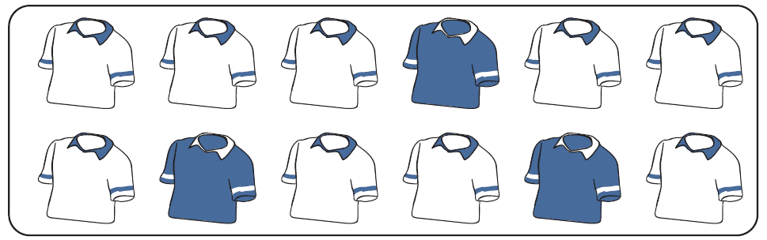
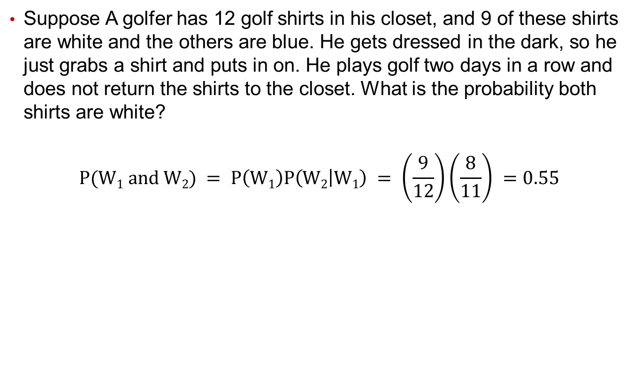
Conditional Probability Example
Suppose A golfer has 12 golf shirts in his closet, and 9 of these shirts are white and the others are blue. He gets dressed in the dark, so he just grabs a shirt and puts in on. He plays golf two days in a row and does not return the shirts to the closet. What is the probability both shirts are white?
$$P(W1 and W2) = P\left(W1\right)P\left(W2 | W1\right) = \left(\frac{9}{12}\right)\left(\frac{8}{11}\right) =0.55$$

